Slide 1

UNIVERSITY MANAGEMENT SYSTEM

Slide 2

Team: UMS_TENSAI
MD ABU SHAHMAN
TARIKUL ISLAM
Sultan AHMED
SADAT ISLAM
MD ALI AKBAR
06.
MD JOBAYER HOSSAN

Slide 3
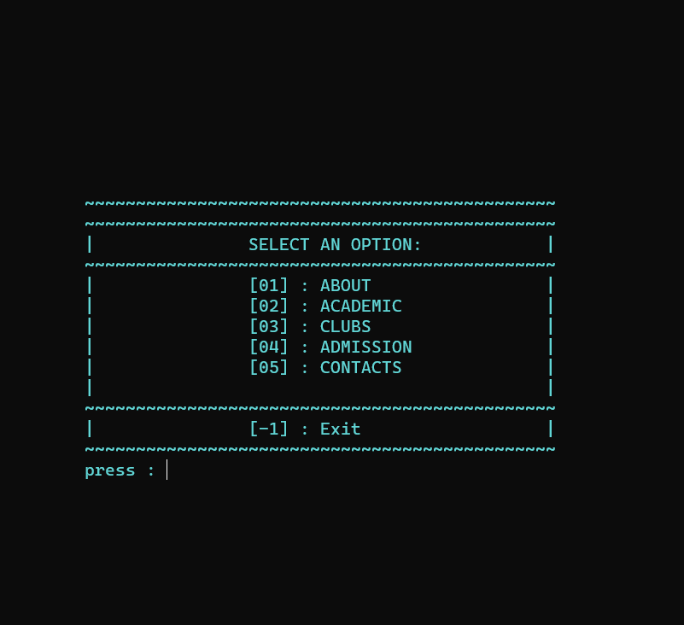
CONTENTS
ABOUT
ACADEMIC
CLUBS
ADMISSION
CONTACTS

Slide 4
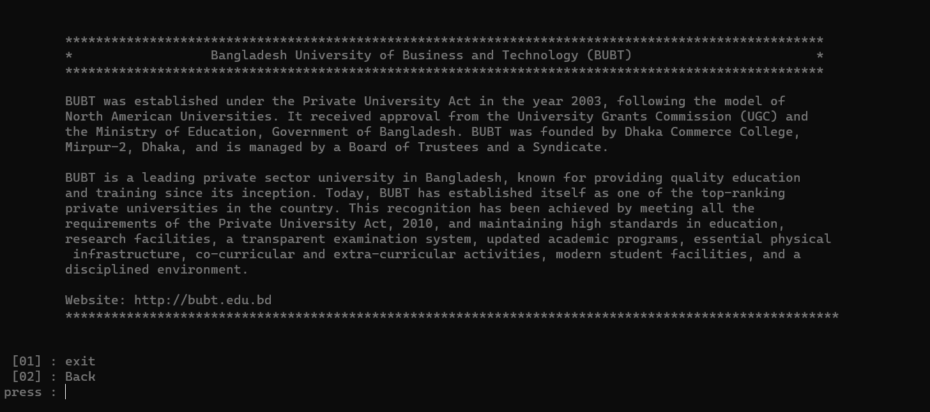
ABOUT
MANU
ABOUT

Slide 5
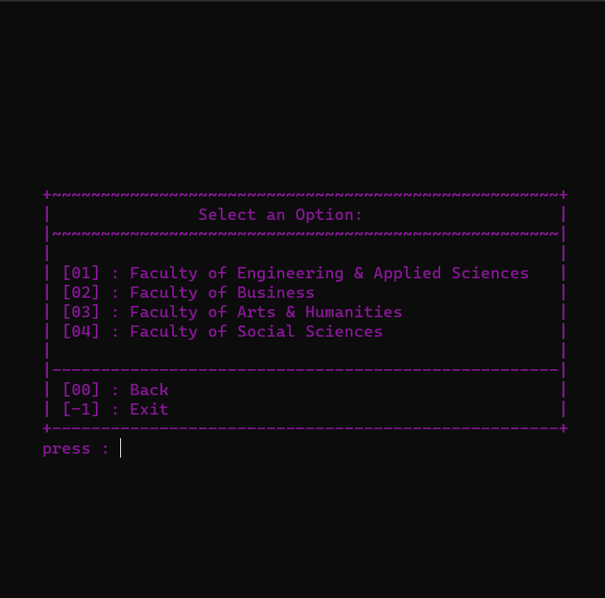
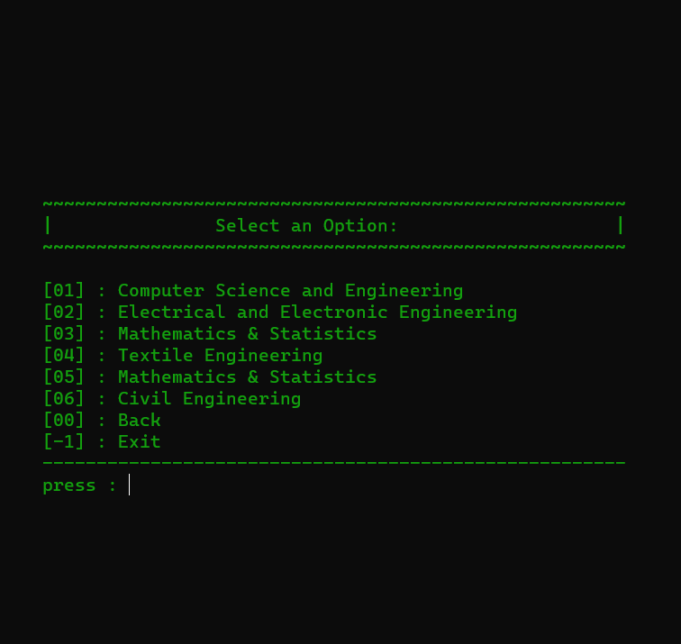
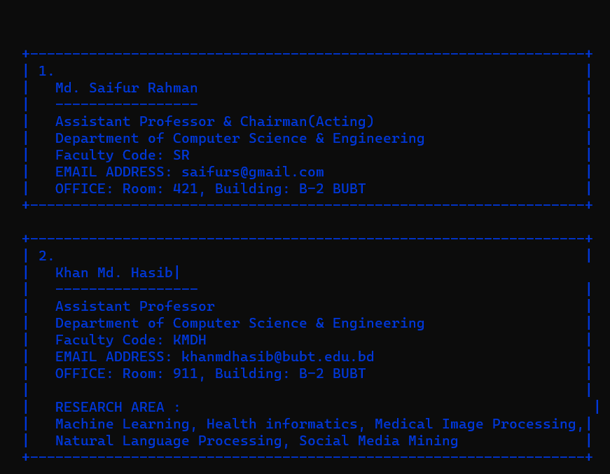
ACADEMIC
Faculty
Department
Teachers

Slide 6
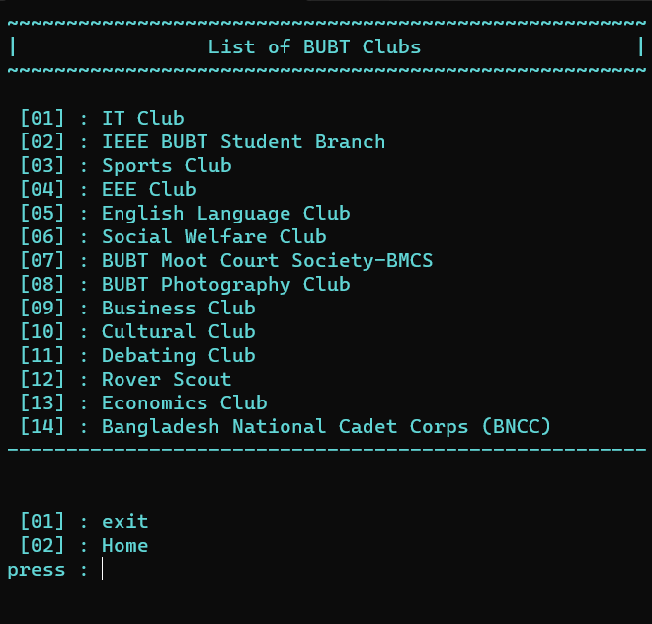
CLUBS

Slide 7
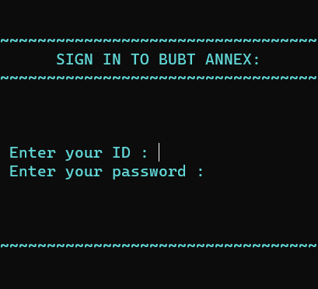
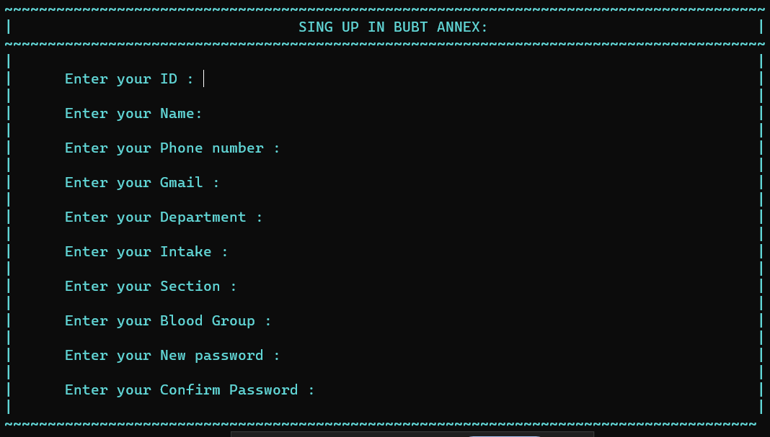
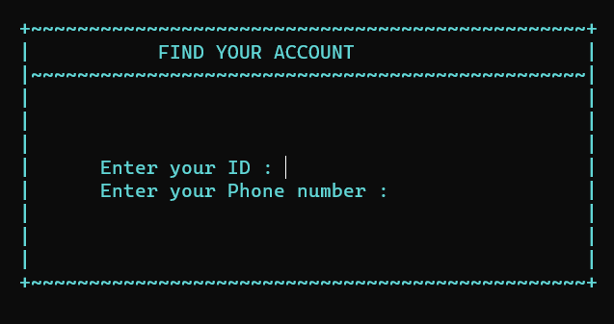
ADMISSION
LOGIN
REGISTRATION
FORGET PASSWORD

Slide 8
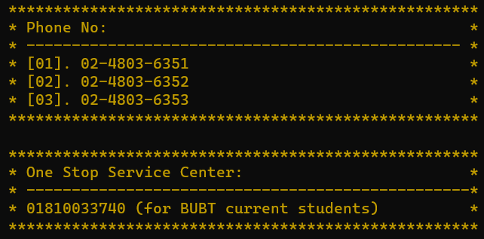
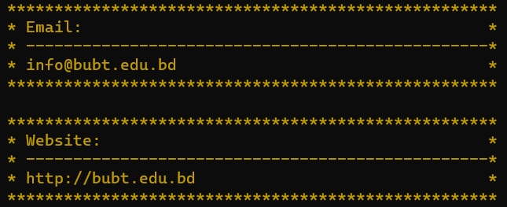
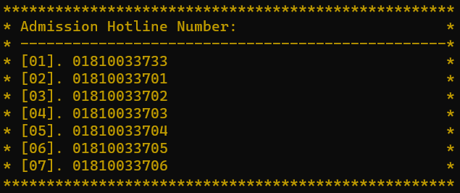
CONTACTS
Phone & One Stop Service Center
Admission Hotline
Email & Website

Slide 9
THANK YOU EVERYONE

